Slide 1
Wondering how to access the reciprocal list?
Click here and follow these steps!

Slide 2
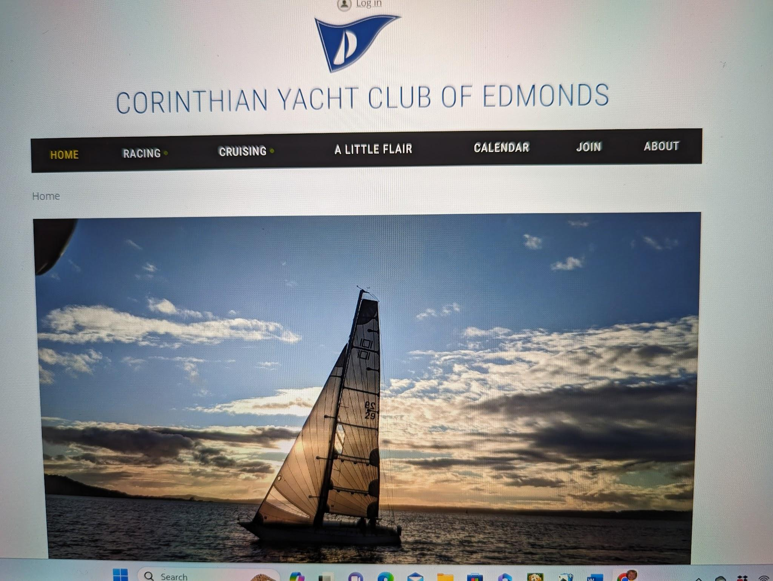
First go the CYCE website where you’ll see this.
https://www.cycedmonds.org/
Click to see next slide.

Slide 3
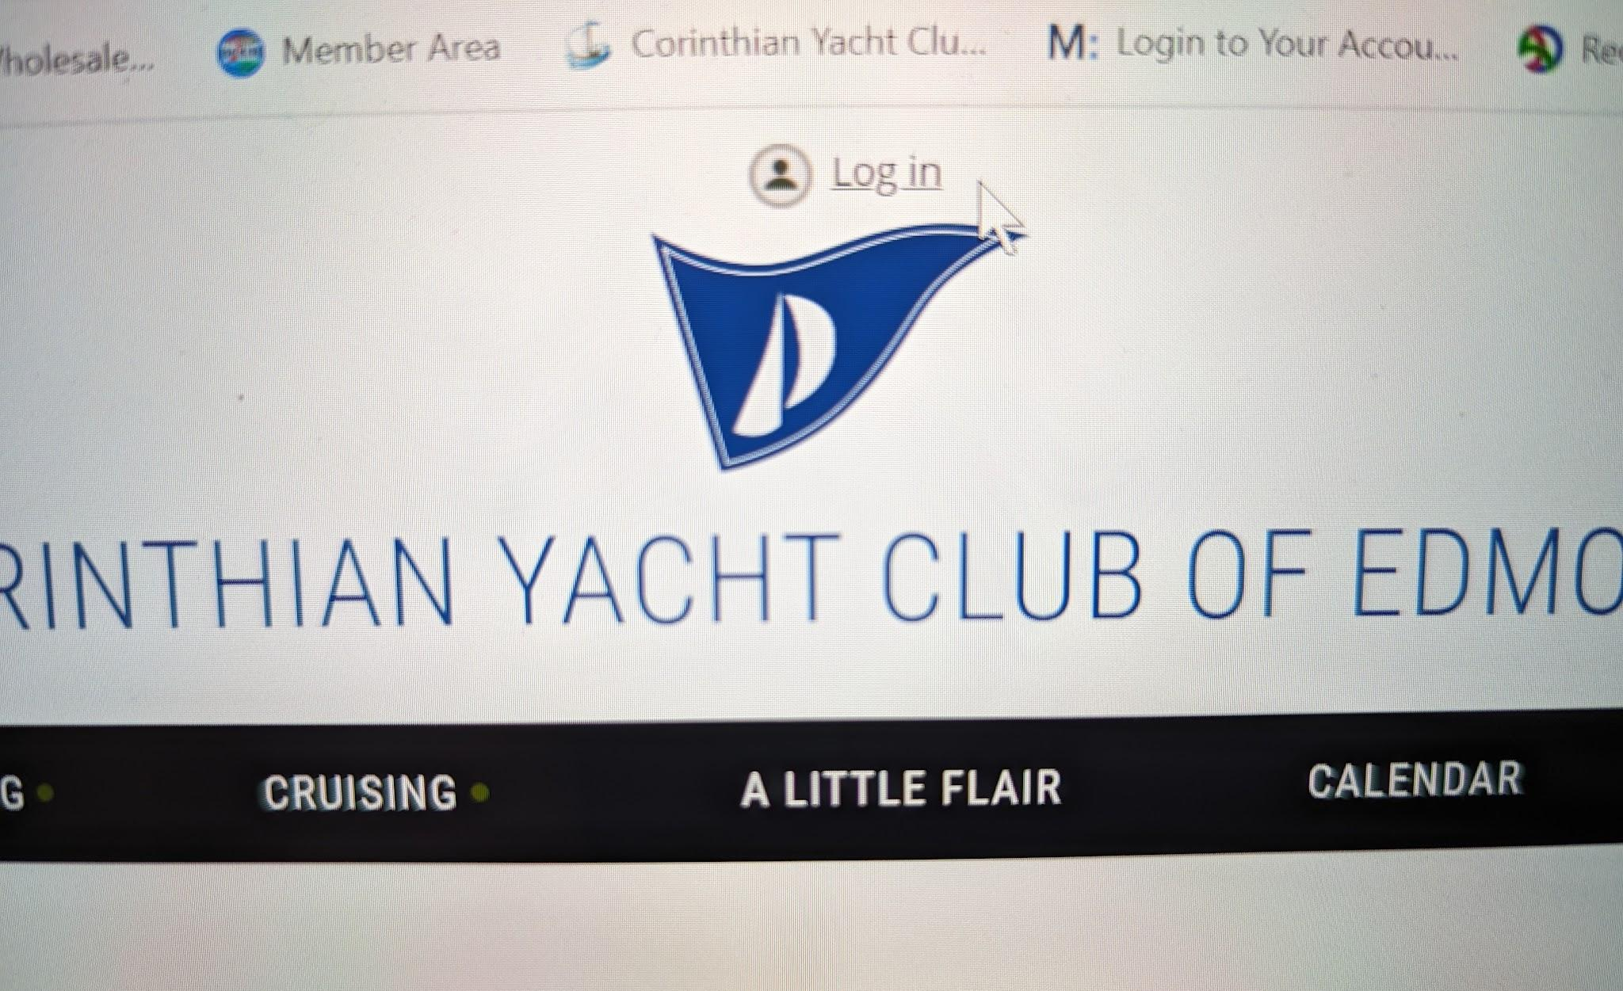
Log in at the top of the page.
Your log-in is your email address. If you forgot your password follow the prompts to get a new one.
Click to see next slide.

Slide 4
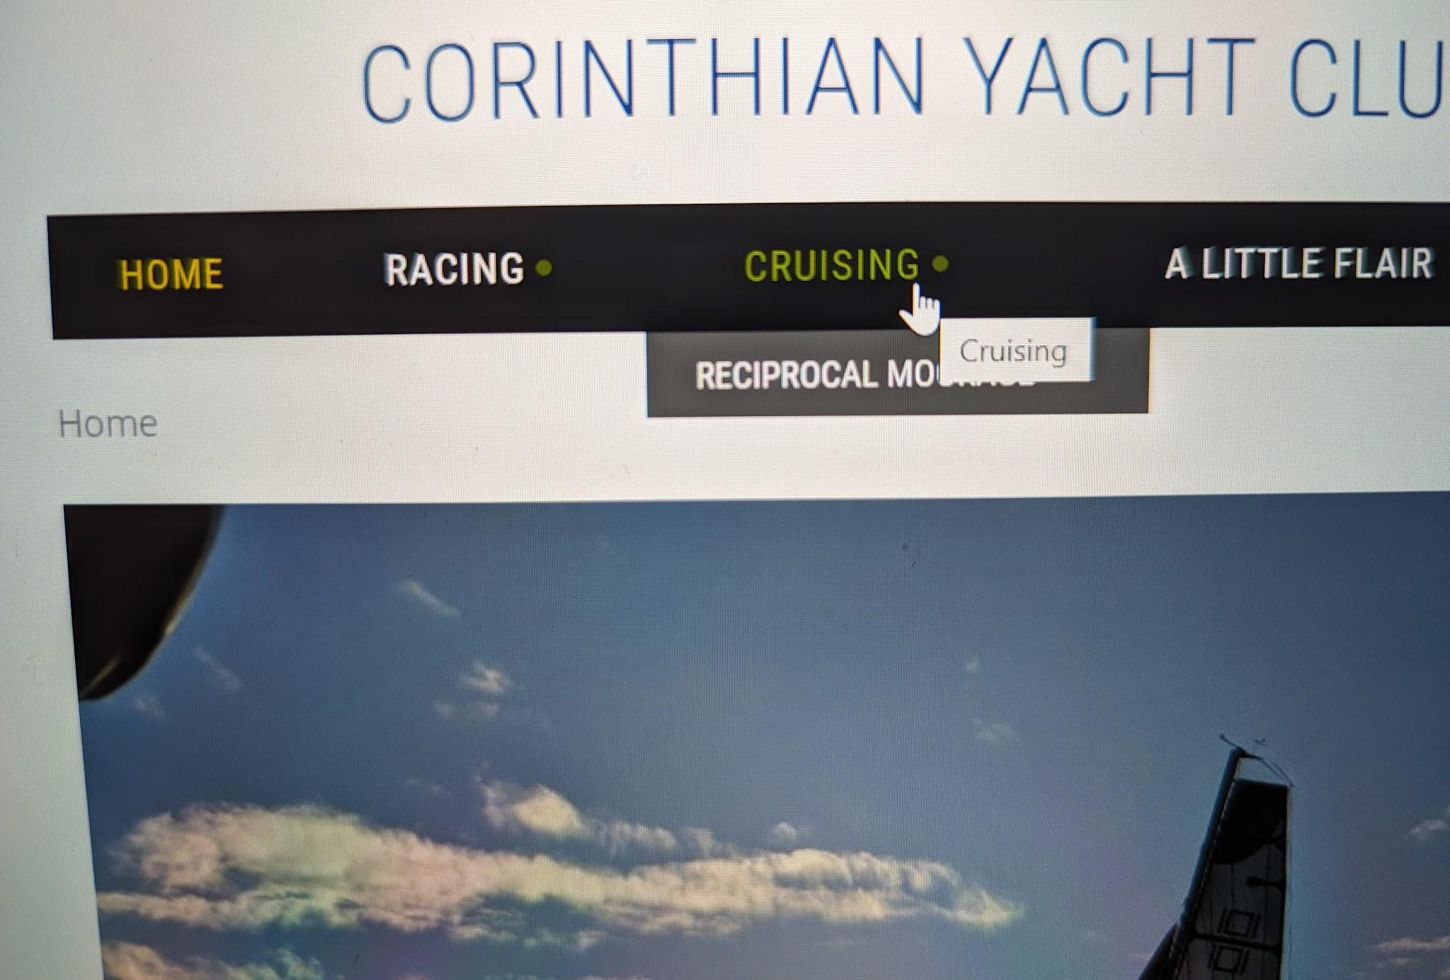
Click on the Cruising tab.
Click to see next slide.

Slide 5
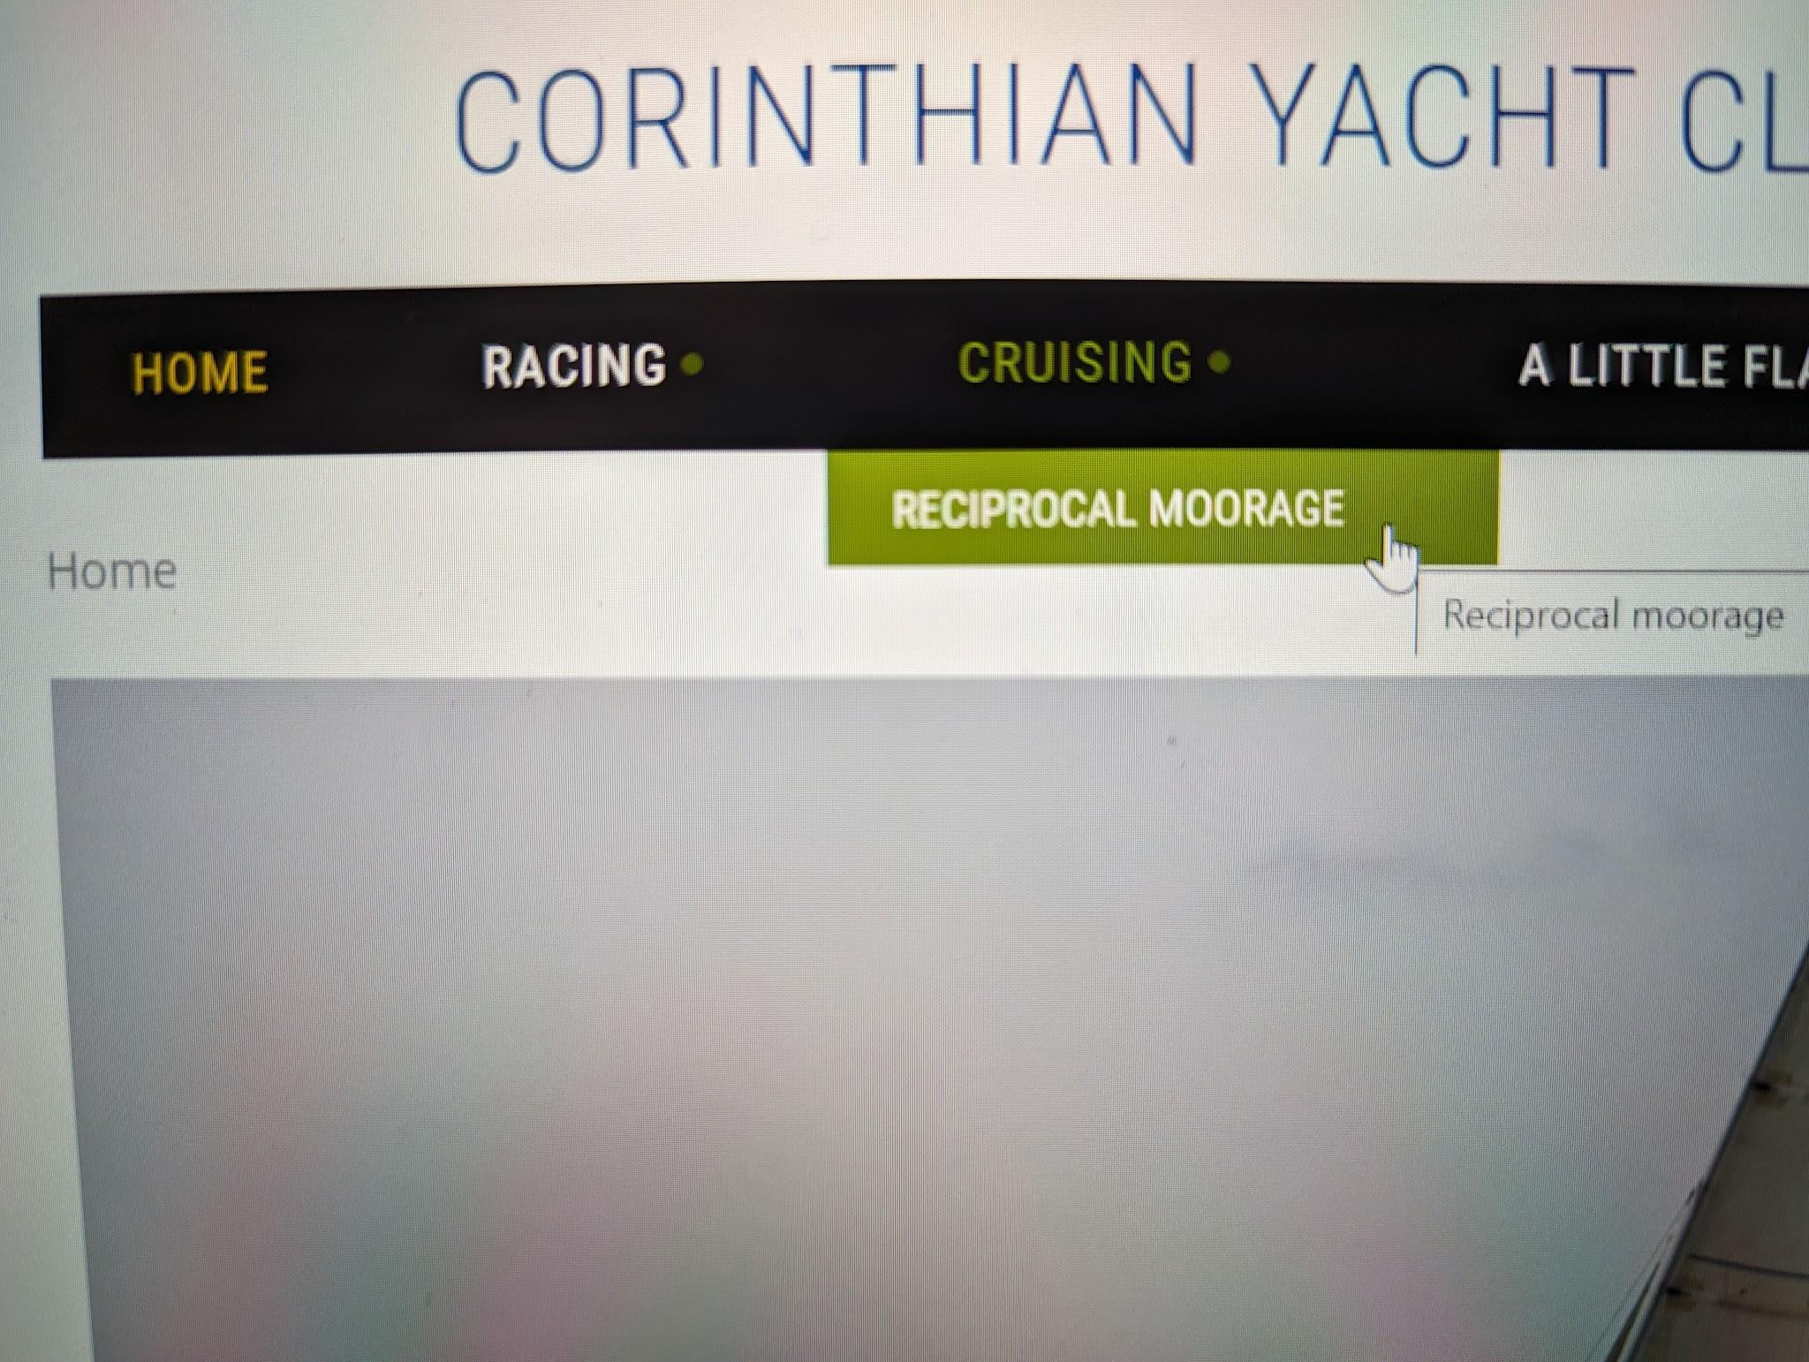
Click on the Reciprocal Moorage tab.
Click to see next slide.

Slide 6
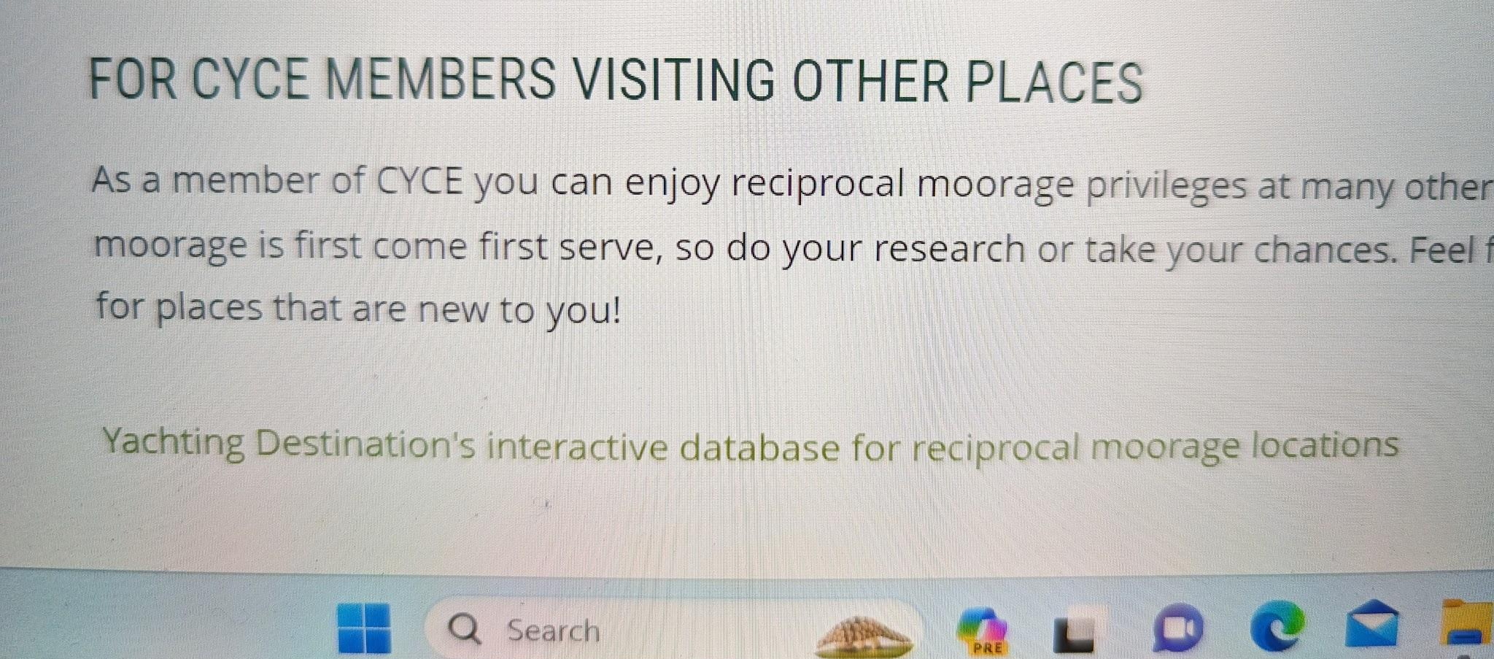
Scroll down to the bottom of the page and click on the green link for Yachting Destinations.
Click to see next slide.

Slide 7
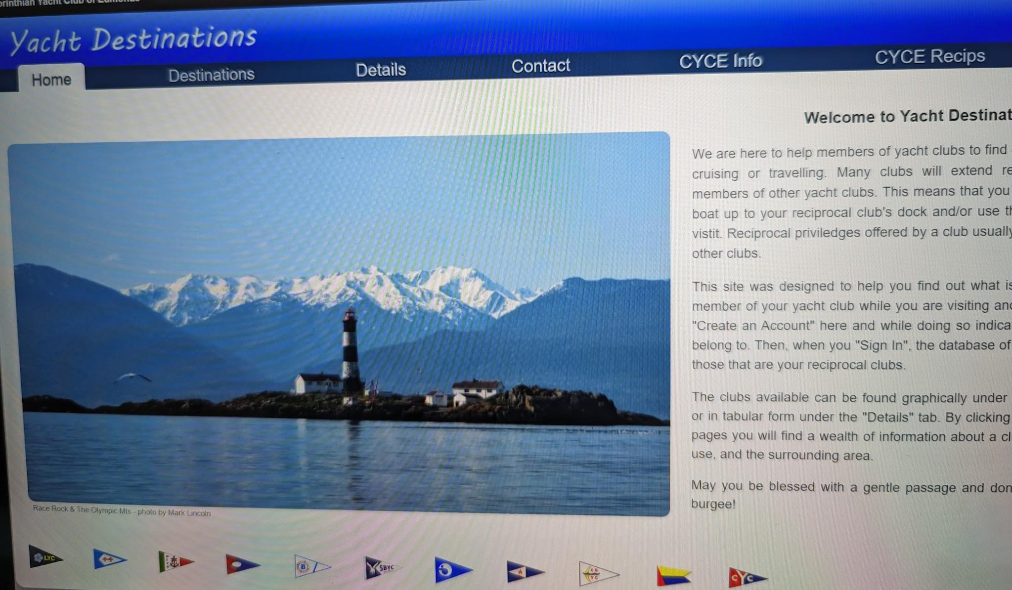
Click to see next slide.
You should see this website.

Slide 8
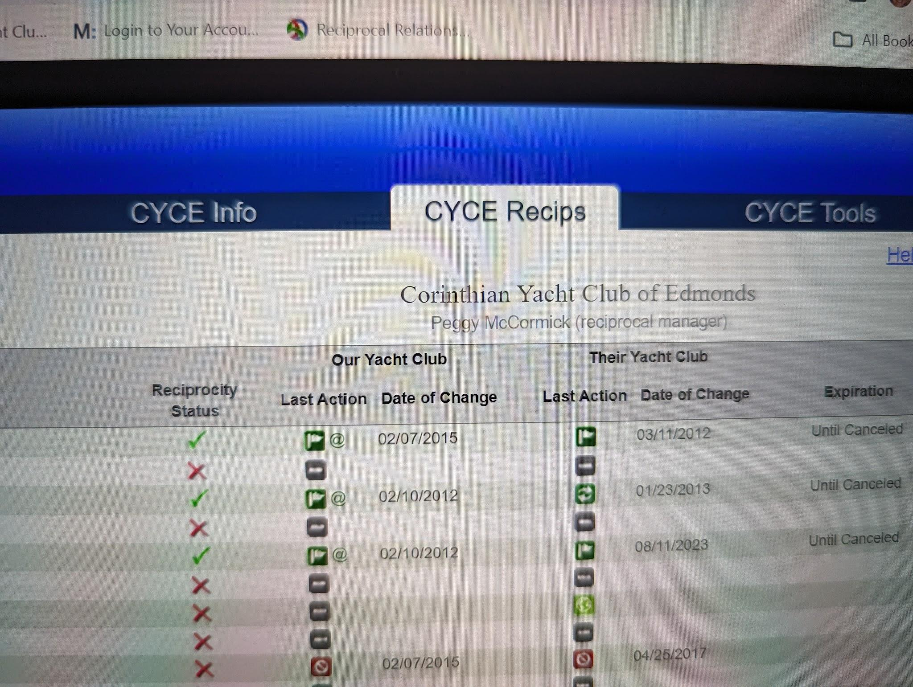
Click on the CYCE Recips tab.
Click to see next slide.

Slide 9
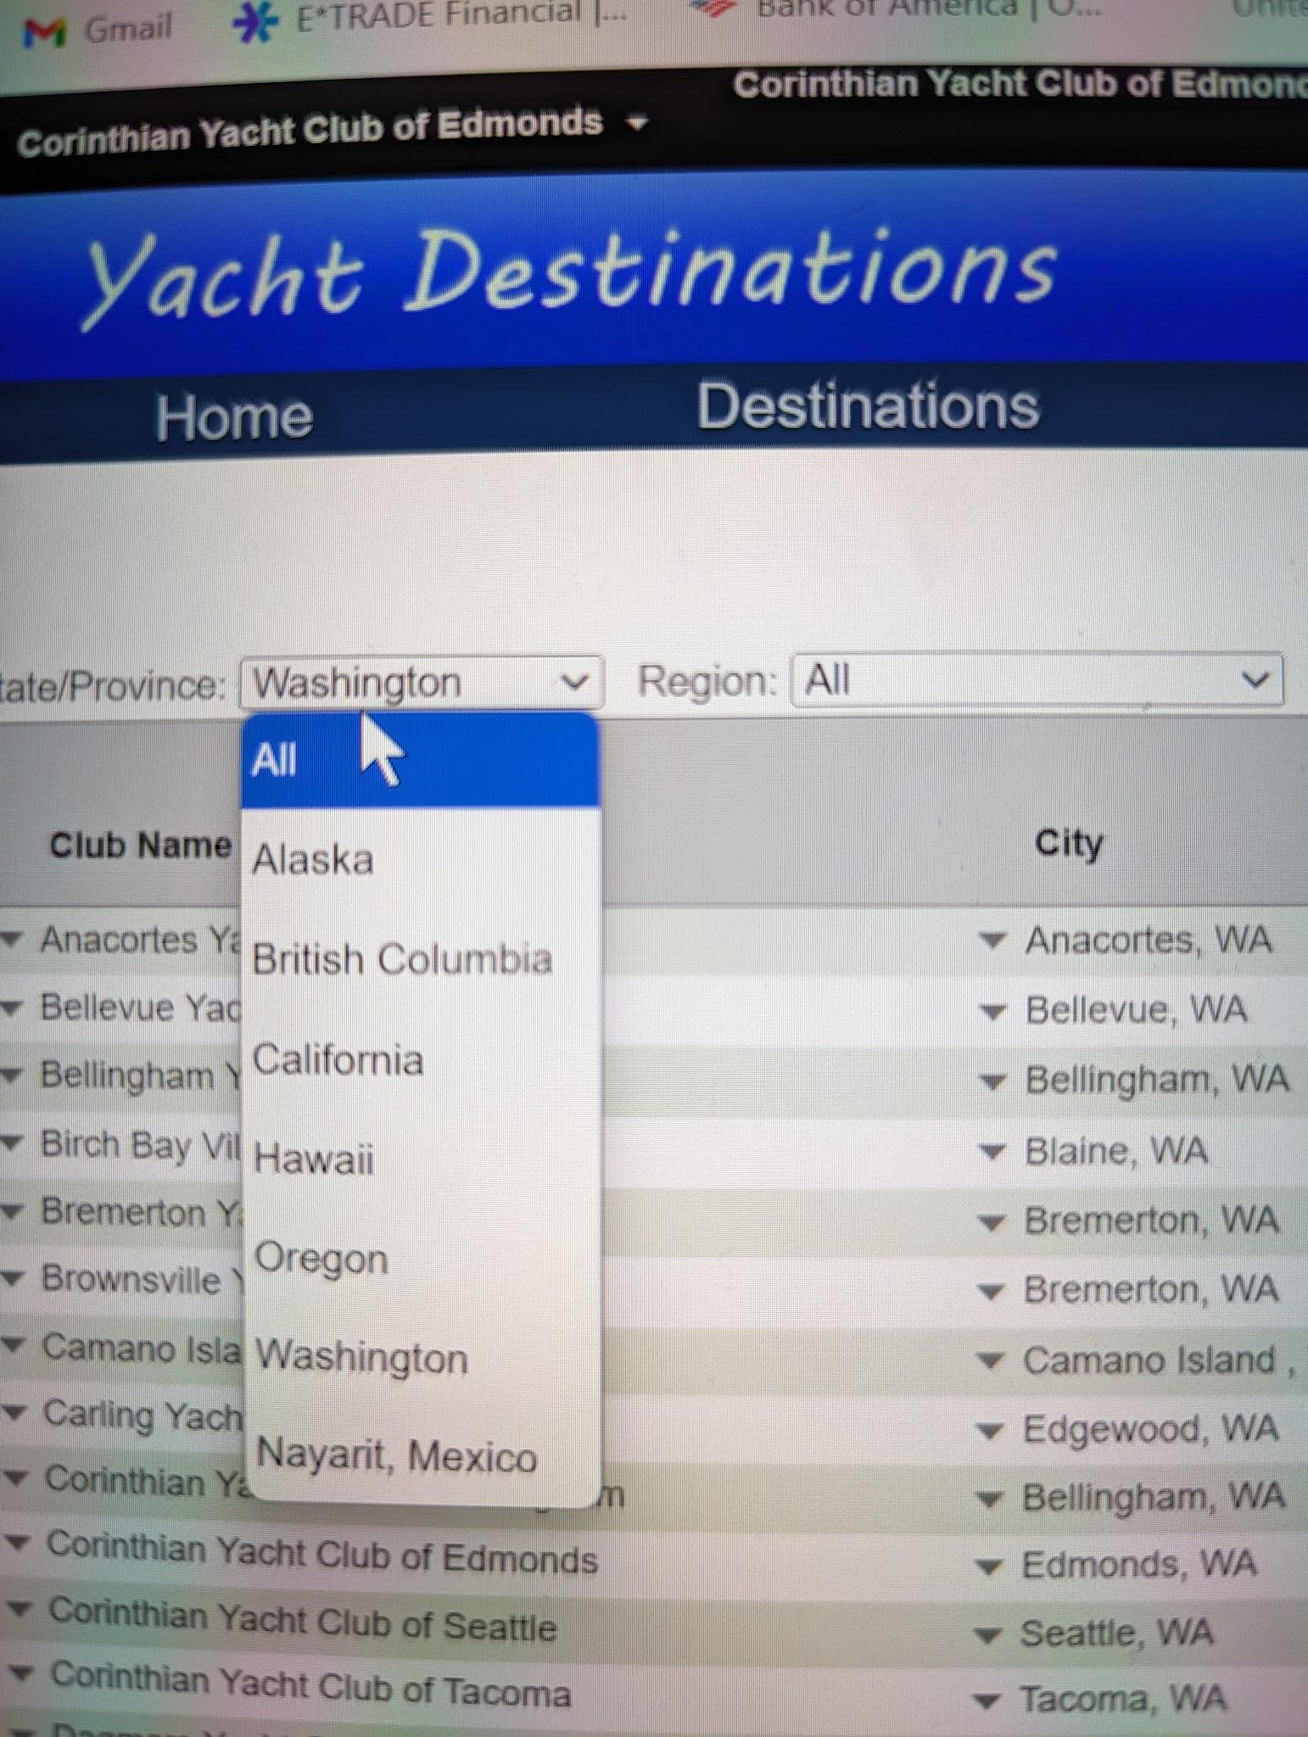
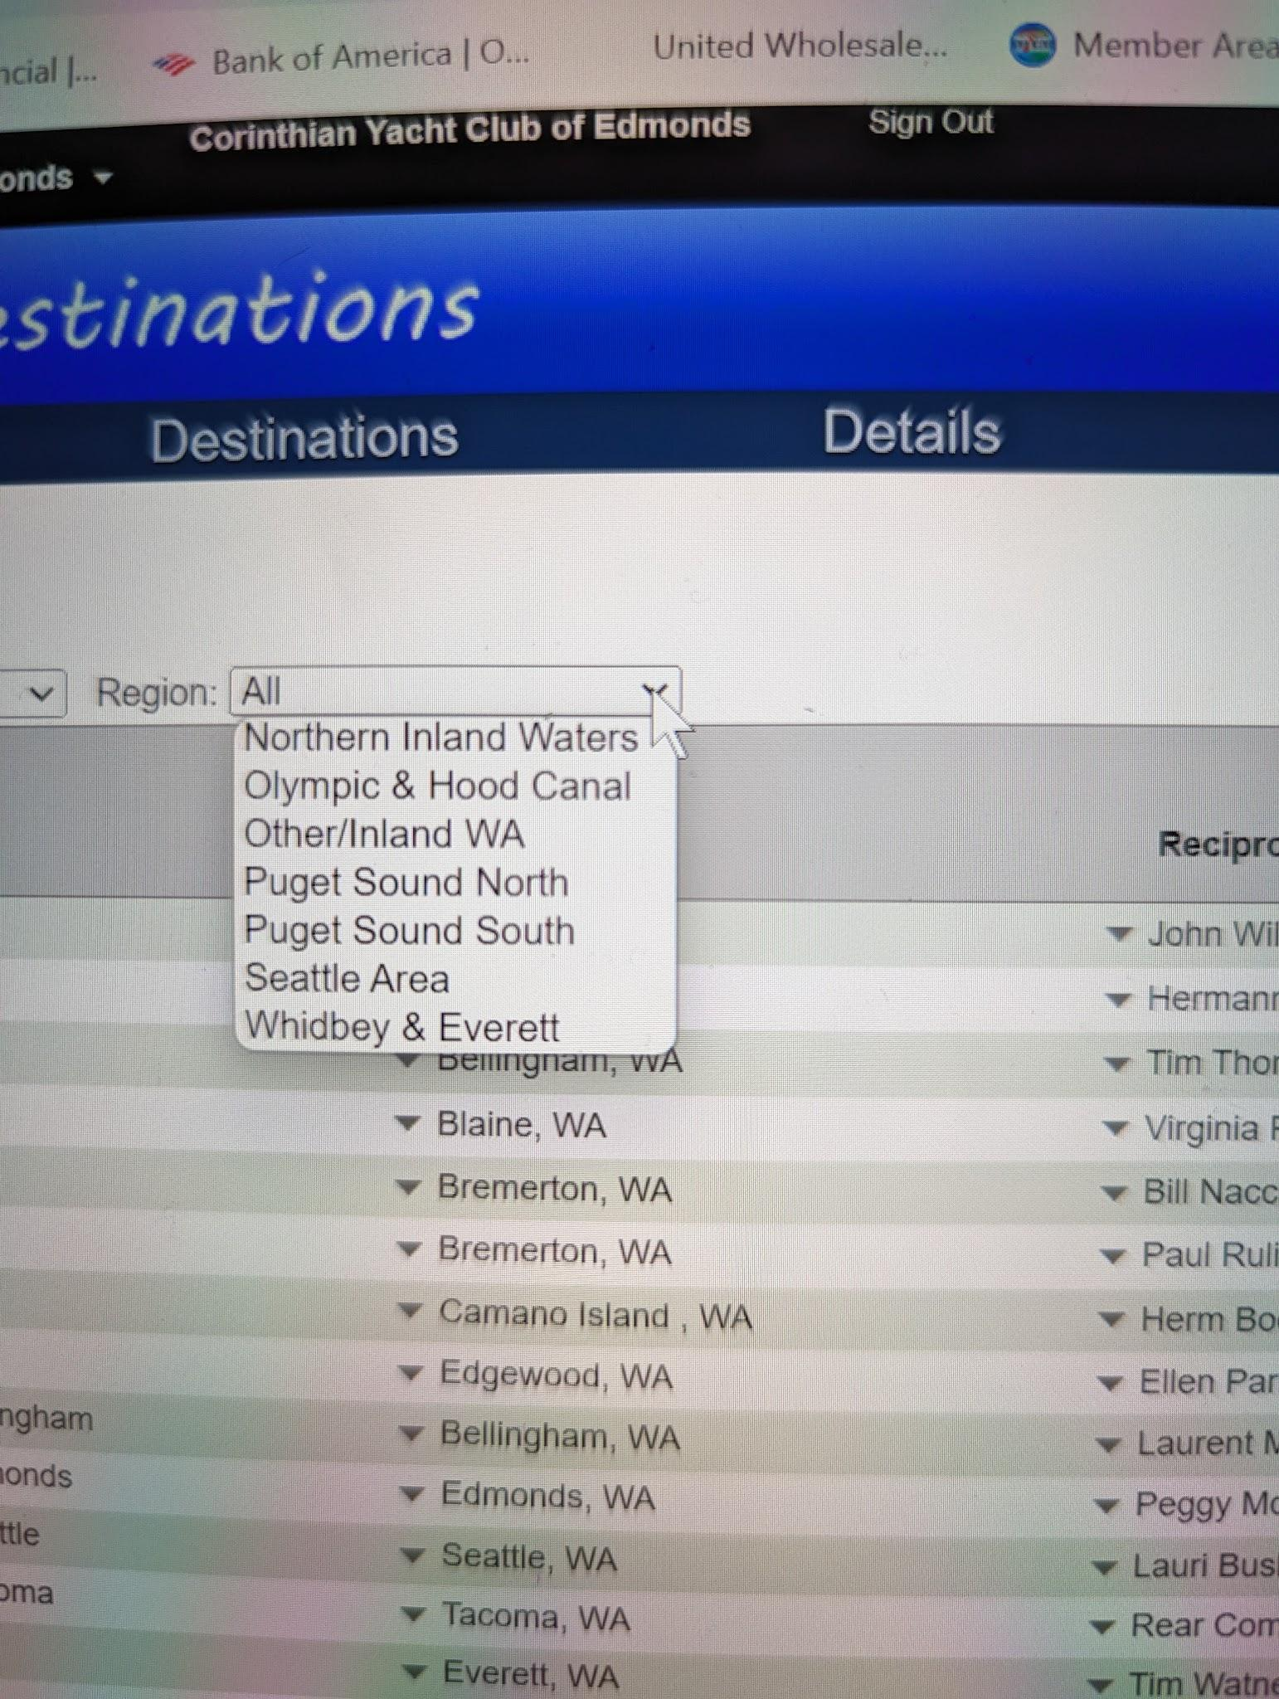
Choose where you want to go. Washington only,
Or out of state, or country locations.
You can also search
by Region.
Click to see next slide.

Slide 10
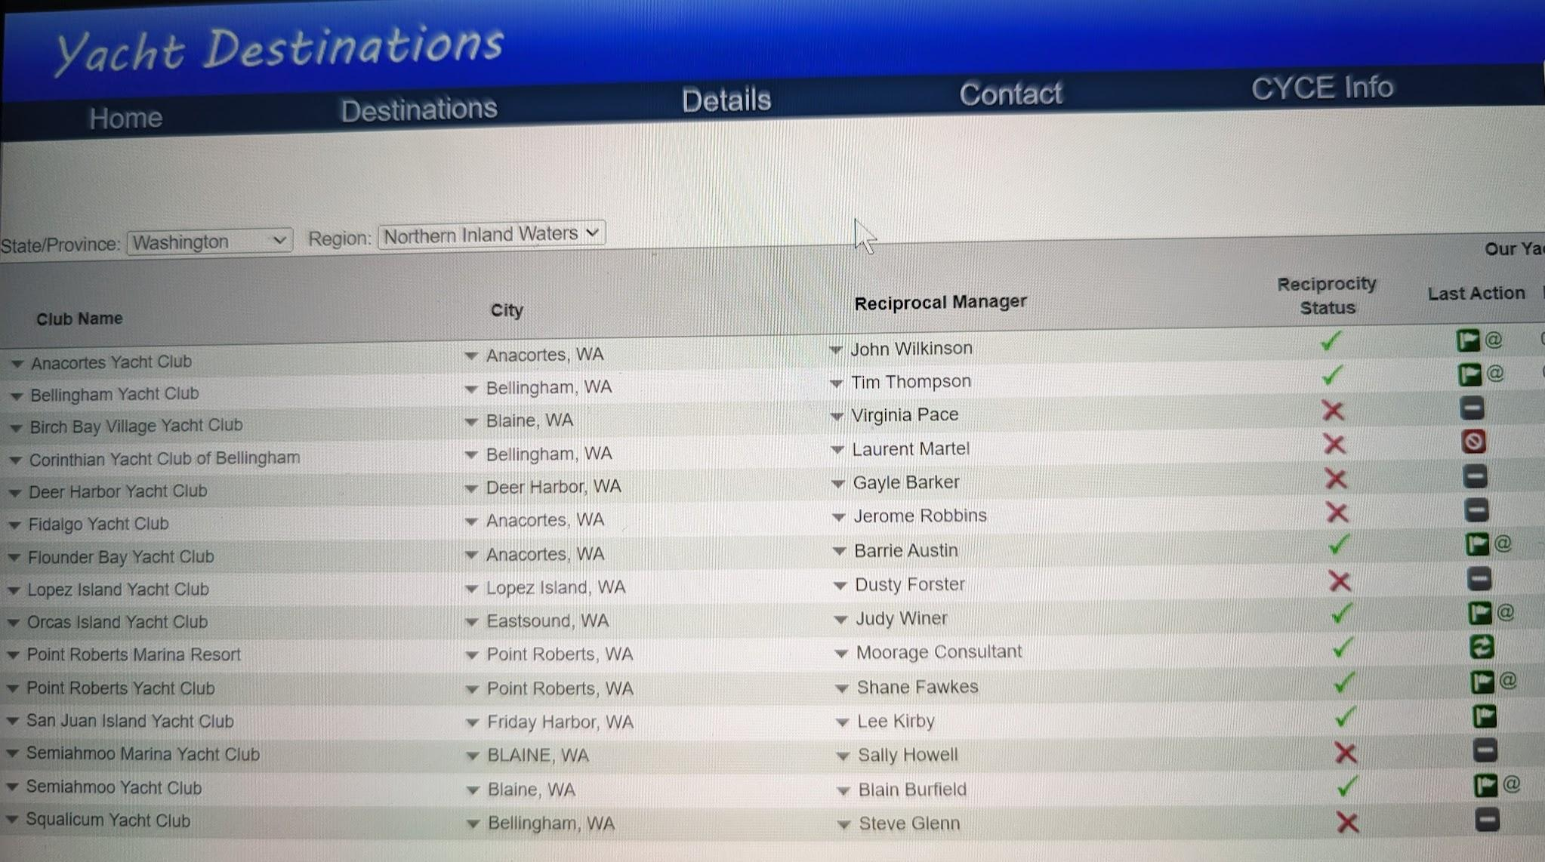
Look for green check marks which indicate that this club has accepted us as reciprocal.
Click to see next slide.

Slide 11
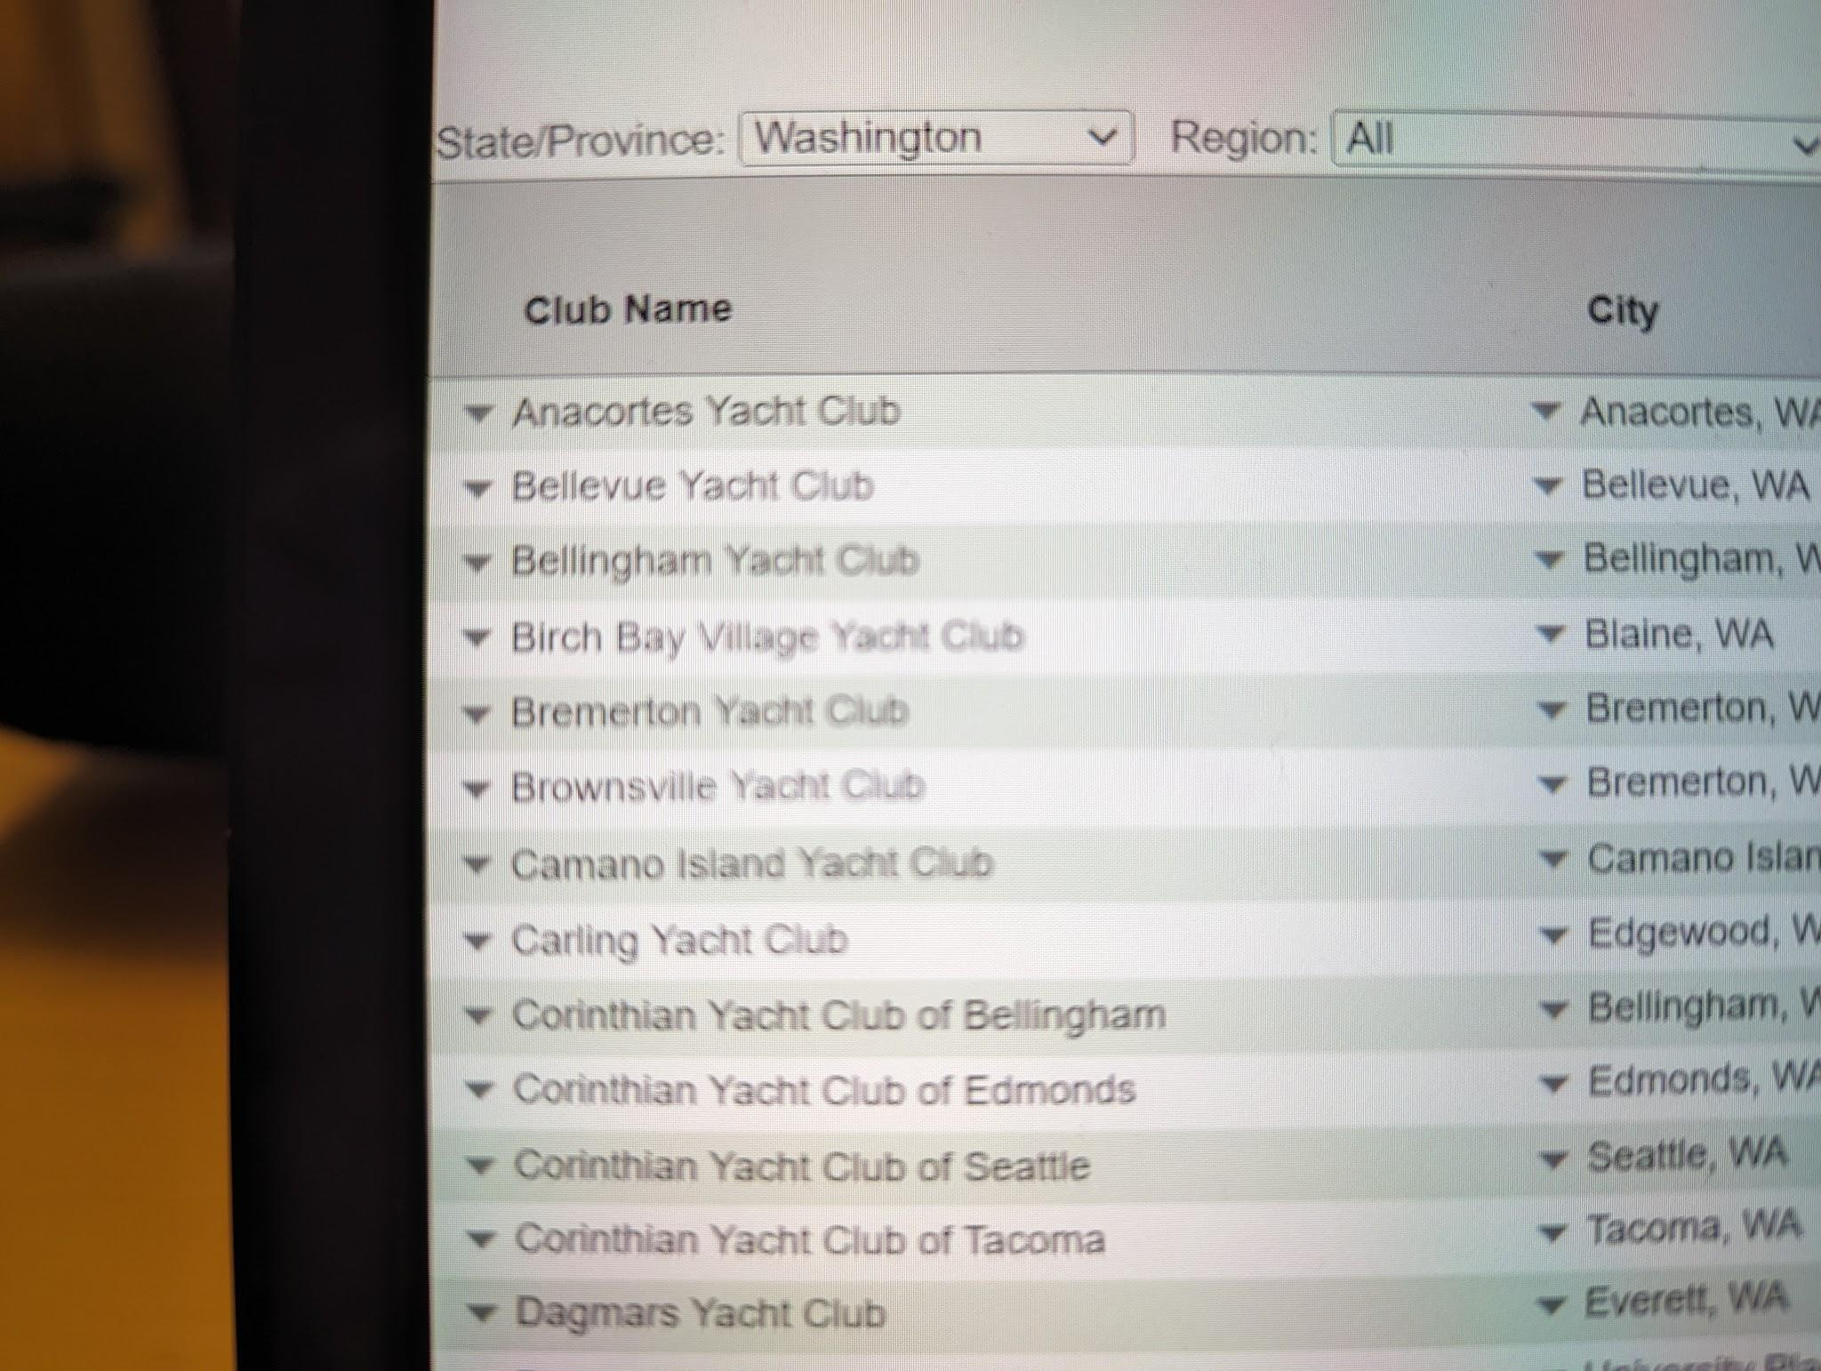
Pick your club and click on the down arrow on the left.
Click to see next slide.

Slide 12
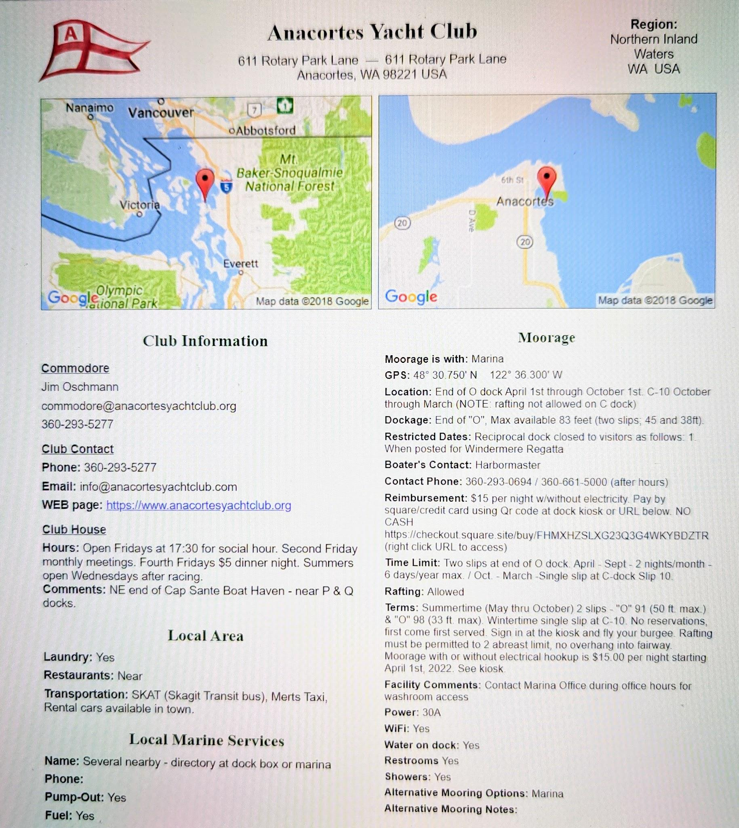
You will find all the information from that club that you need to contact them and use their reciprocal moorage.

